Slide 1
RECOVERY WEEKLY PROGRESS REPORT.
WEEK 10

Slide 2
Tasks completed.
Fabrication of the new Power Distribution Board and Flight Computer for the Drone Test.
Design of the Avionics Bay Holder for the Drone test.

Slide 3
1. New POWER DISTRIBUTION BOARD.
Following the Drone Test that was carried out on 23rd March 2023, various observations and conclusions were made.
Among the issues, of great concern was the failure of Power supply to the various components.
Below is how we structured our Power flow which enabled us to troubleshoot.

Slide 4
Battery Li-Po
11.1V
Buck Converter Circuitry.
5V
ESP32 MICROCONTROLLER
3.3V
BMP 180
MPU 6050

Slide 5
In the above methodology of Supply, the Battery’s voltage (11.1V) is stepped down to 5V by the Buck Converter.
The Buck converter’s output powers the ESP32 Microcontroller which in turn powers the BMP 180 and MPU 6050 sensors which were used for the test with its 3.3V output.
The ESP and the sensors turned on when connected when powered by a USB cable connected to the Laptop, while when connected to the battery, there was no power flow to the sensors. This was the main cause of the failure of the drone test.

Slide 6
Due to this, we noticed that the configuration used to power the whole system was wrong and we decided to restructure the flow of Power.
Furthermore, we also realized that there was a short circuit in the Flight Computer Board which caused power not to flow to the Sensors.
Due to this reason, we came up with a new Design of Power flow as shown in the next slide.

Slide 7
Batter Li-Po
11.1V
11.1V
Protection Circuit
Nichrome Wire
11.1V
9V
Buck Converter.
9V
9V
GPS
5V Regulator LM 7805
3.3V Regulator AMS 1117
5V
3.3V
ESP32 MICROCONTROLLER
SENSORS (MPU 6050 AND BMP 180)

Slide 8
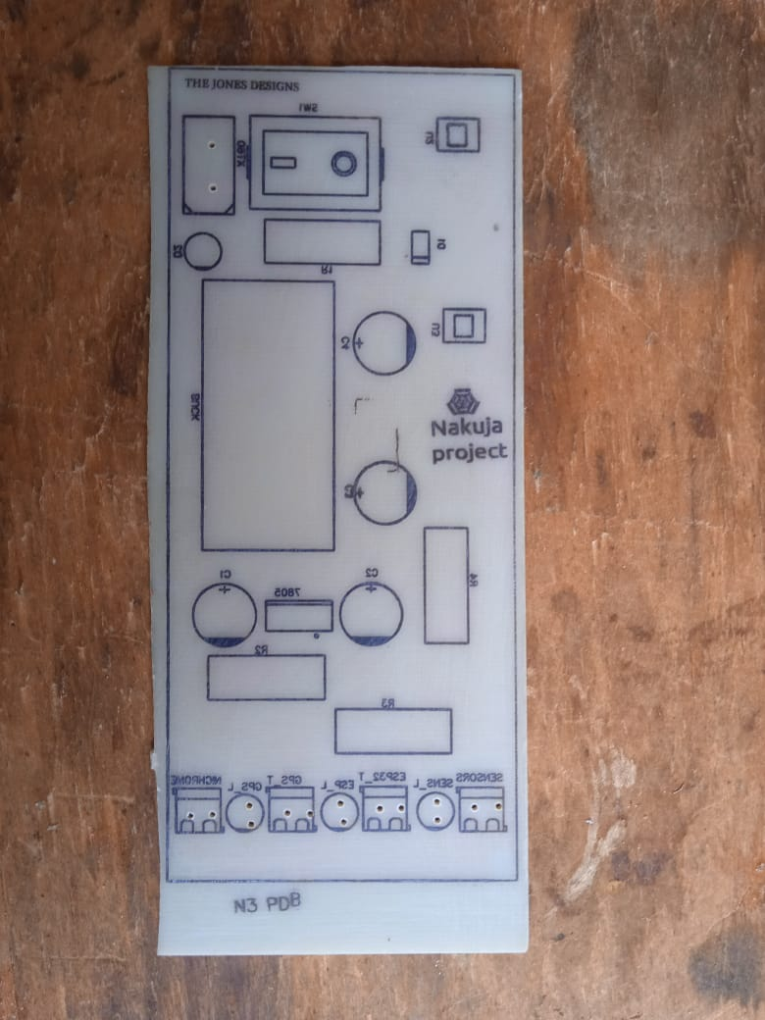
Below are the results of the New Board.

Slide 9
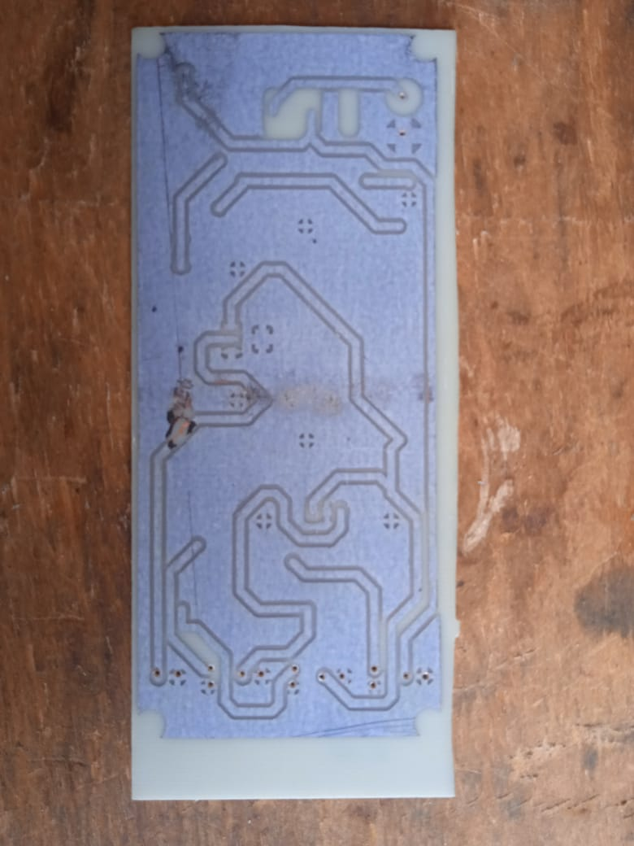

Slide 10
The New PDB has already been made and we are looking forward for the arrival of the ordered components so that soldering and testing of the boards may commence.

Slide 11
2. Design of the Avionics Bay Holder for the Drone test
In line with the drone test conclusions and recommendation, we thought of replacing the method of supporting the Avionics bay using strings attached to the drone stands.
This method proved inefficient and risky since the Bay was susceptible to movement and rotation causing the antenna pointing direction to wonder off and hence loss of connection.
Also, the Bay would not be stable and could even fall if the strings were not tightly secured to the drone.

Slide 12
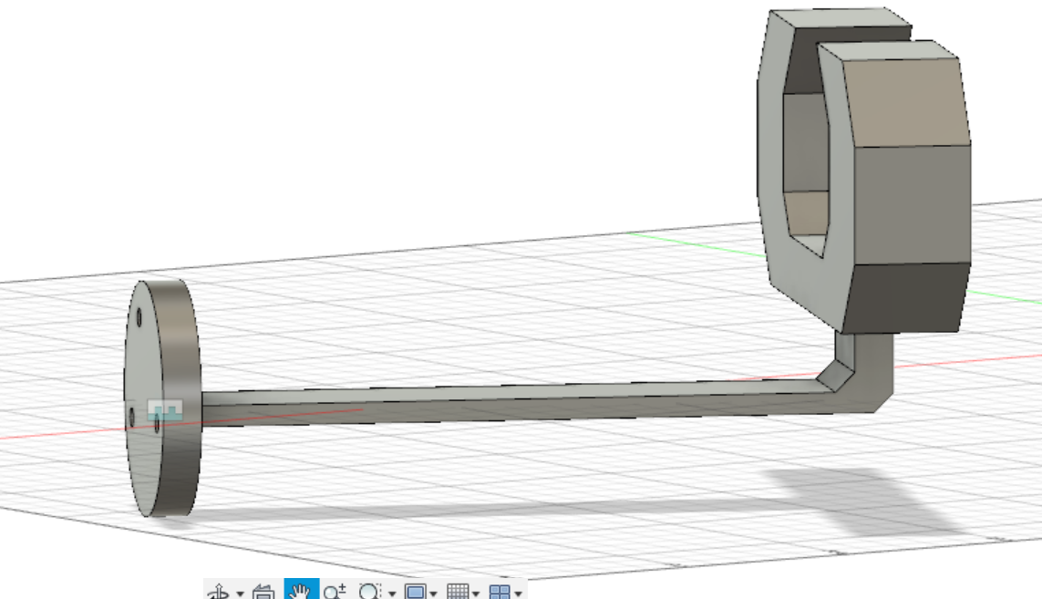
For this reason, an Avionics Bay holder was designed to the dimensions of the Drone Stand width and the Circumference of the Avionics Bay. Below is the 3D view of the same.

Slide 13
Next Week’s tasks.
Completion of the Drone Test.
Design of the Final N3 Rocket PCBs, namely, the PDB, Flight Computer Board, Ejection Board and the Ground Computer Board.
Fabrication of the Ejection Piston Safety Stand.

